Slide 1
IPv4

Slide 2
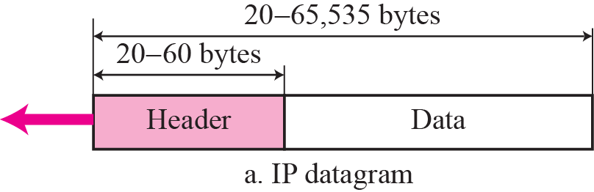
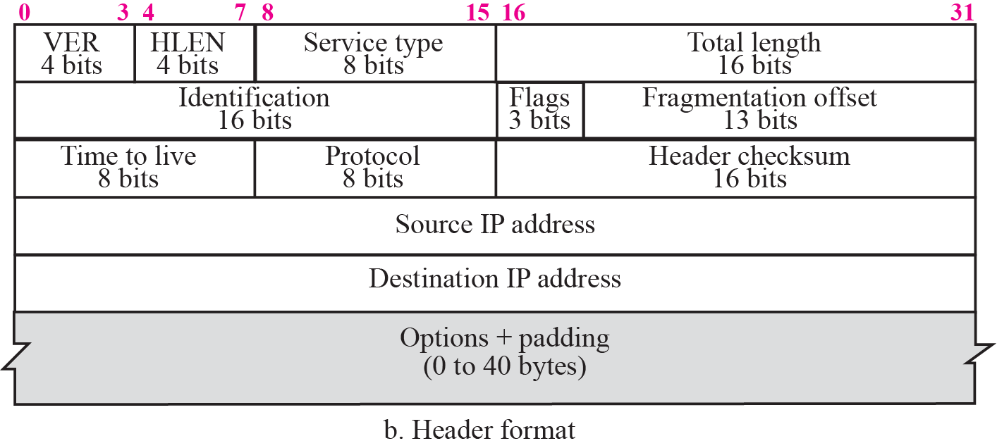
Figure 7.2 IP datagram

Slide 3
Example 7.1
An IP packet has arrived with the first 8 bits as shown:
The receiver discards the packet. Why?
Solution
There is an error in this packet. The 4 left-most bits (0100) show the version, which is correct. The next 4 bits (0010) show the wrong header length (2 × 4 = 8). The minimum number of bytes in the header must be 20. The packet has been corrupted in transmission.

Slide 4
Example 7.2
In an IP packet, the value of HLEN is 1000 in binary. How many bytes of options are being carried by this packet?
Solution
The HLEN value is 8, which means the total number of bytes in the header is 8 × 4 or 32 bytes. The first 20 bytes are the base header, the next 12 bytes are the options.

Slide 5
Example 7.3
In an IP packet, the value of HLEN is 5₁₆ and the value of the total length field is 0028₁₆. How many bytes of data are being carried by this packet?
Solution
The HLEN value is 5, which means the total number of bytes in the header is 5 × 4 or 20 bytes (no options). The total length is 40 bytes, which means the packet is carrying 20 bytes of data (40 − 20).

Slide 6
Example 7.4
An IP packet has arrived with the first few hexadecimal digits as shown below:
How many hops can this packet travel before being dropped? The data belong to what upper layer protocol?
Solution
To find the time-to-live field, we skip 8 bytes (16 hexadecimal digits). The time-to-live field is the ninth byte, which is 01. This means the packet can travel only one hop. The protocol field is the next byte (02), which means that the upper layer protocol is IGMP (see Table 7.2)

Slide 7
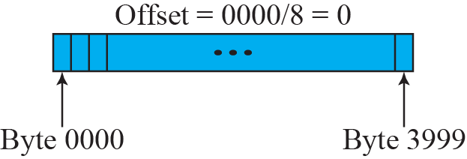
Figure 7.8 Fragmentation example

Slide 8
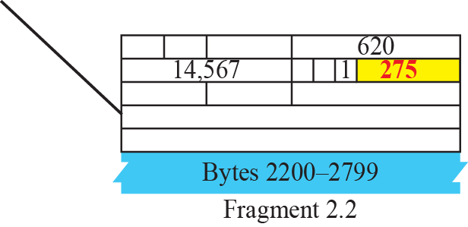
Figure 7.9 Detailed fragmentation example

Slide 9
Example 7.5
A packet has arrived with an M bit value of 0. Is this the first fragment, the last fragment, or a middle fragment? Do we know if the packet was fragmented?
Solution
If the M bit is 0, it means that there are no more fragments; the fragment is the last one. However, we cannot say if the original packet was fragmented or not. A nonfragmented packet is considered the last fragment.

Slide 10
Example 7.6
A packet has arrived with an M bit value of 1. Is this the first fragment, the last fragment, or a middle fragment? Do we know if the packet was fragmented?
Solution
If the M bit is 1, it means that there is at least one more fragment. This fragment can be the first one or a middle one, but not the last one. We don’t know if it is the first one or a middle one; we need more information (the value of the fragmentation offset). See also the next example.

Slide 11
Example 7.7
A packet has arrived with an M bit value of 1 and a fragmentation offset value of zero. Is this the first fragment, the last fragment, or a middle fragment?
Solution
Because the M bit is 1, it is either the first fragment or a middle one. Because the offset value is 0, it is the first fragment.

Slide 12
Example 7.8
A packet has arrived in which the offset value is 100. What is the number of the first byte? Do we know the number of the last byte?
Solution
To find the number of the first byte, we multiply the offset value by 8. This means that the first byte number is 800. We cannot determine the number of the last byte unless we know the length of the data.

Slide 13
Example 7.9
A packet has arrived in which the offset value is 100, the value of HLEN is 5 and the value of the total length field is 100. What is the number of the first byte and the last byte?
Solution
The first byte number is 100 × 8 = 800. The total length is 100 bytes and the header length is 20 bytes (5 × 4), which means that there are 80 bytes in this datagram. If the first byte number is 800, the last byte number must be 879.

Slide 14
19-1 IPv4 ADDRESSES
An IPv4 address is a 32-bit address that uniquely and universally defines the connection of a device (for example, a computer or a router) to the Internet.
Topics discussed in this section:
Address Space Notations
Classful Addressing
Classless Addressing
Network Address Translation (NAT)

Slide 15
IPv4 addressing
An IPv4 address is a 32-bit address that uniquely and universally defines the connection of a device (for example, a computer or a router) to the Internet.
The IPv4 addresses are unique and universal.
The address space of IPv4 is 2³² or 4,294,967,296.
Notes:
172.50.60.0 - 172.50.60.255

Slide 16
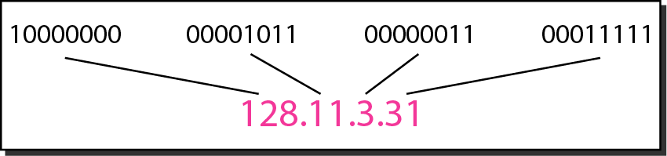
Figure 19.1 Dotted-decimal notation and binary notation for an IPv4 address

Slide 17
Example 19.1
Change the following IPv4 addresses from binary notation to dotted-decimal notation.
Solution
We replace each group of 8 bits with its equivalent decimal number (see Appendix B) and add dots for separation.

Slide 18
Example 19.2
Change the following IPv4 addresses from dotted-decimal notation to binary notation.
Solution
We replace each decimal number with its binary equivalent (see Appendix B).

Slide 19

Note
In classful addressing, the address space is divided into five classes:
A, B, C, D, and E.

Slide 20
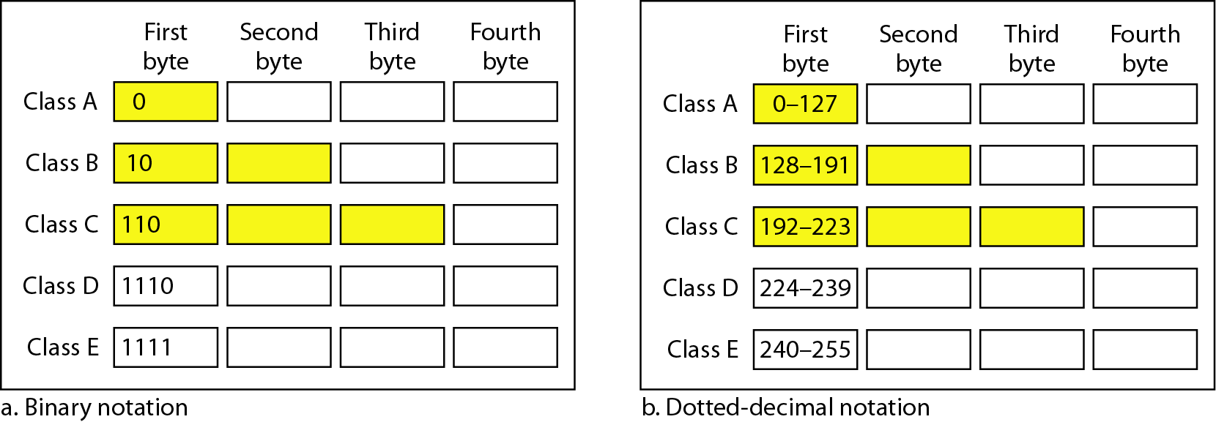
Figure 19.2 Finding the classes in binary and dotted-decimal notation
Notes:
32
8bit(N) 24bits(H)

Slide 21
Example 19.4
Find the class of each address.
a. 00000001 00001011 00001011 11101111
b. 11000001 10000011 00011011 11111111
c. 14.23.120.8
d. 252.5.15.111
Solution
a. The first bit is 0. This is a class A address.
b. The first 2 bits are 1; the third bit is 0. This is a class C address.
c. The first byte is 14; the class is A.
d. The first byte is 252; the class is E.

Slide 22
Table 19.1 Number of blocks and block size in classful IPv4 addressing
Notes:
0 0000000

Slide 23
Note
In classful addressing, a large part of the available addresses were wasted.

Slide 24
Table 19.2 Default masks for classful addressing

Slide 25
Note
Classful addressing, which is almost obsolete, is replaced with classless addressing.

Slide 26
Note
In IPv4 addressing, a block of addresses can be defined as
x.y.z.t /n
in which x.y.z.t defines one of the addresses and the /n defines the mask.

